Slide 1
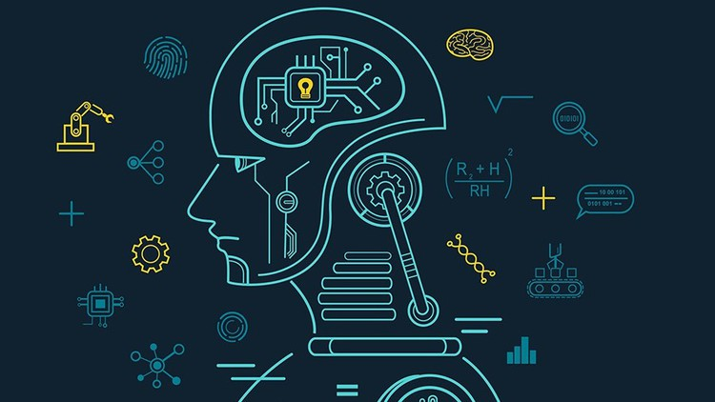
Disease Prediction Using Machine Learning.
SARTHAK SAHAI MENTOR:
2017000 Dr. Manoj Diwaker
SEC-”A” Professor, Dept. of CSE

Slide 2
INTRODUCTION:
Welcome to the presentation on disease prediction using machine learning.
In this presentation, we will explore the innovative approach of leveraging machine learning algorithms to predict diseases based on symptom analysis.
By harnessing the power of data-driven insights, our project aims to contribute to early detection, personalized treatment strategies, and improved patient outcomes.
We will delve into the methodology, results, and future directions of our project, highlighting its potential impact on the field of healthcare.

Slide 3
PROBLEM STATEMENT:
Traditional disease prediction methods suffer from limitations in accuracy, time-consuming analysis, and incomplete understanding of complex symptom patterns. These challenges hinder the effectiveness of disease prediction in healthcare, leading to misdiagnoses, delays in treatment, and inadequate patient care. There is a pressing need for advanced machine learning techniques that can improve disease prediction accuracy, reduce analysis time, and enable a comprehensive understanding of complex symptom interactions. By addressing these challenges, we aim to enhance healthcare interventions, facilitate timely and accurate diagnoses, and improve patient outcomes.

Slide 4
METHODOLOGY:
Data Collection:
Gather a comprehensive dataset of symptoms and disease labels from diverse healthcare sources.
Ensure the dataset is representative and covers a wide range of diseases.
Data Preprocessing:
Cleanse the collected data by removing duplicates and handling missing values.
Normalize or scale the data to ensure compatibility with machine learning algorithms.

Slide 5
ALGORITHMS:
Decision Tree Algorithm.
A popular machine learning method for both classification and regression applications is the Decision Tree algorithm. By dividing the feature space according to the values of the attributes, it creates a hierarchical structure in the shape of a tree to make predictions. Each leaf node of the tree represents a class label or a prediction, whereas each internal node stands for a test on an attribute.
Recursively dividing the data into homogeneous subgroups based on several attributes is necessary while building a decision tree. The impurity or homogeneity within each subset is minimized or increased by this partitioning technique. The Gini Index and Information Gain are the two most widely used impurity measurements.

Slide 6
Naive Bayes.
A popular probabilistic machine learning approach for classification tasks is called Naive Bayes. Because it relies on the Bayes theorem and assumes that each attribute exists independently of the others, it is referred to as "naive." Contrary to popular belief, Naive Bayes has shown to be efficient in a variety of real-world applications and can produce reliable classification results.
The algorithm determines the posterior probability of each class given the observable features for a new instance in order to make predictions. As the anticipated class label for the instance, it chooses the class label with the highest probability.
Random Forest.
An ensemble learning method called Random Forest mixes various decision trees to produce predictions. It works by building a variety of decision trees, each trained on a haphazard portion of the training data and taking a haphazard subset of features into account. The random selection of data samples and feature sets introduces diversity, which lowers the likelihood of overfitting and enhances the model's overall performance.

Slide 7
The use of Random Forest in disease prediction offers several advantages. Firstly, it leverages the collective wisdom of multiple decision trees, resulting in more accurate predictions compared to using a single decision tree. The ensemble nature of Random Forest helps to reduce the impact of individual decision trees' biases and limitations, leading to better generalization and improved prediction performance.
GUI Development.
A graphical user interface (GUI) was created using Tkinter, a well-liked Python GUI framework, to improve the user experience. People might easily input their symptoms for disease prediction using the GUI's user-friendly platform. To ensure usability and boost user engagement, it utilized intuitive design elements, such as clear instructions and user-friendly input fields. The underlying machine learning algorithms were linked with the GUI, enabling real-time symptom data analysis and disease predictions depending on the chosen algorithms.

Slide 8
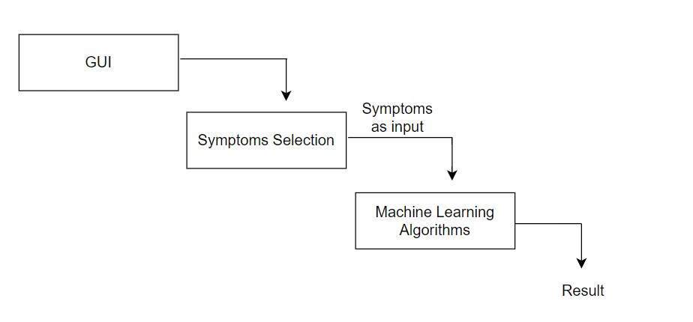
Workflow:

Slide 9
Result and conclusion:
Our project yielded promising results in disease prediction using machine learning algorithms. The performance evaluation of the models demonstrated significant improvements in accuracy compared to traditional methods.
The successful development of the user-friendly graphical user interface (GUI) facilitated convenient symptom input and real-time disease predictions. The GUI enhanced accessibility and usability, making the prediction process intuitive and efficient for healthcare professionals.
In conclusion, our project demonstrated the potential of machine learning algorithms in enhancing disease prediction accuracy. The utilization of Random Forest, Naive Bayes, and Decision Tree algorithms, combined with the user-friendly GUI, contributed to accurate and efficient disease predictions.

Slide 10
Future Work And Implementation:
Moving forward, there are several exciting avenues for future exploration and improvement in disease prediction using machine learning. Some potential directions include:
Enhancing the quality and diversity of the dataset to improve prediction models and account for different populations and disease variations.
Exploring advanced machine learning techniques, such as deep learning or ensemble methods, to further enhance prediction accuracy and capture complex patterns.
Integrating additional data sources, such as electronic health records, genomics, or lifestyle factors, to create more comprehensive and personalized disease prediction models.
Evaluating the performance of the disease prediction system in real-world healthcare settings and assessing its impact on clinical decision-making and patient outcomes.
Let's move to the implementation

